Slide 1
Artifacts
Selections!

Slide 2
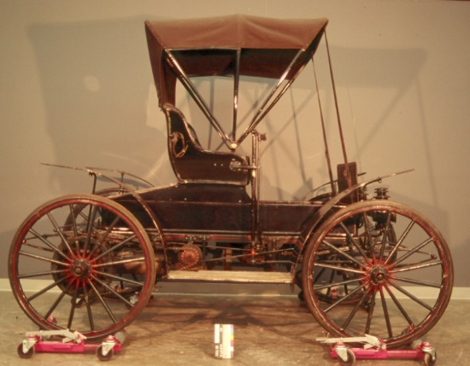
1967.0031
Dianne Greggain

Slide 3
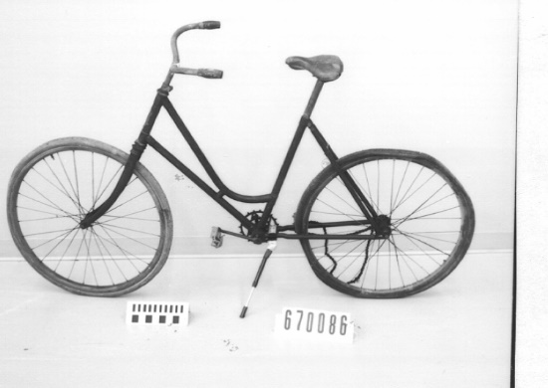
1967.0086
Holly Benison

Slide 4
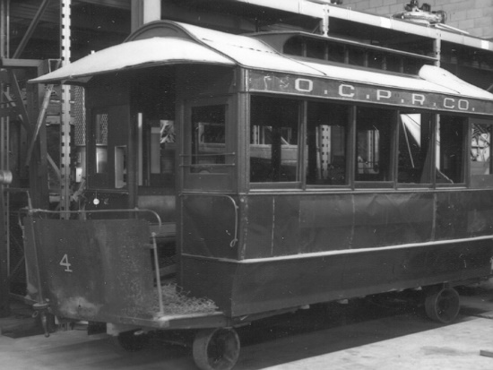
1967.0233
Megan Gellatly

Slide 5
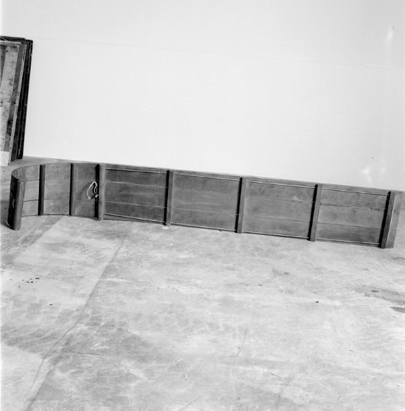
1969.1126
Chantal Lafond

Slide 6
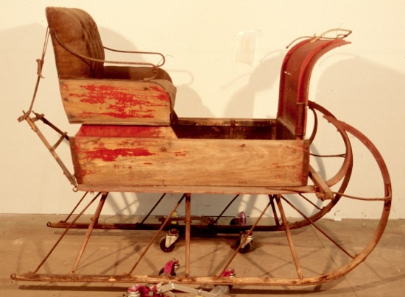
1969.1176
Annabelle Laura Morgan

Slide 7
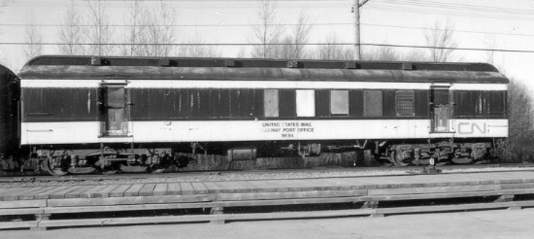
1971.0388
Frédérique LaBerge

Slide 8
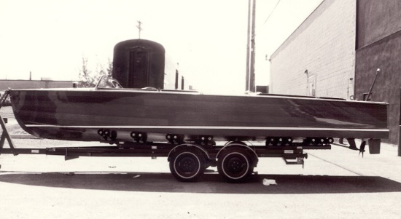
1972.0533
Teri Blades

Slide 9
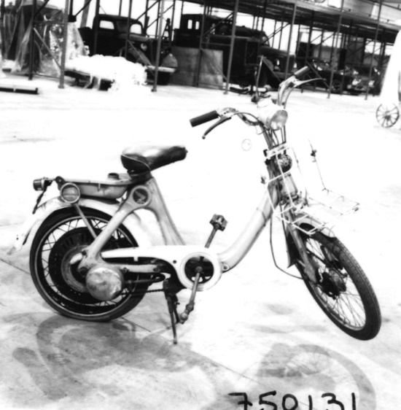
1975.0131
Jennifer Fawcett

Slide 10
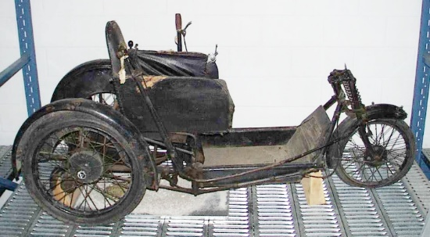
1975.0514
Brooklyn Lahey

Slide 11
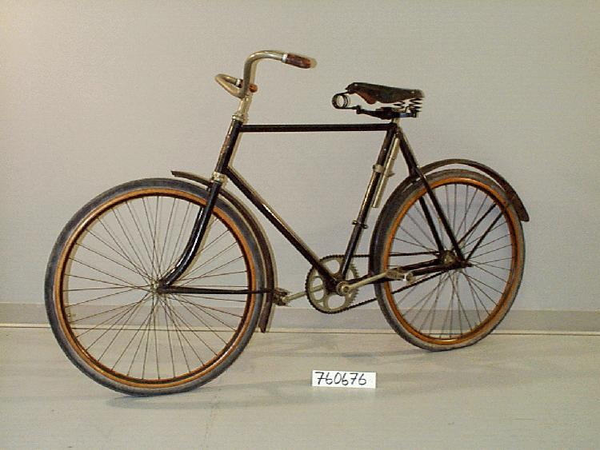
1976.0676
Jing Xiang

Slide 12
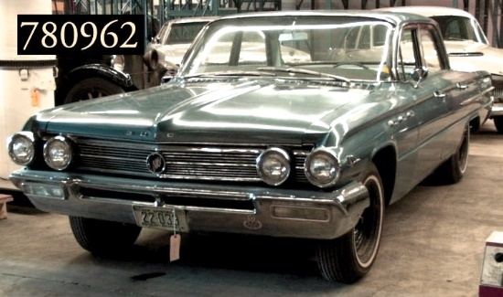
1978.0962
Lily Rousseau

Slide 13
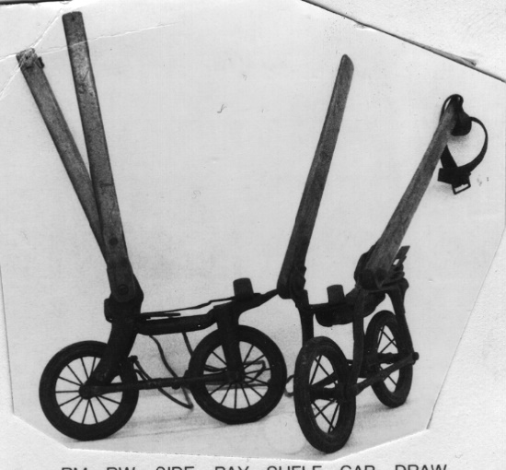
1981.0247
Jessica Lintz

Slide 14
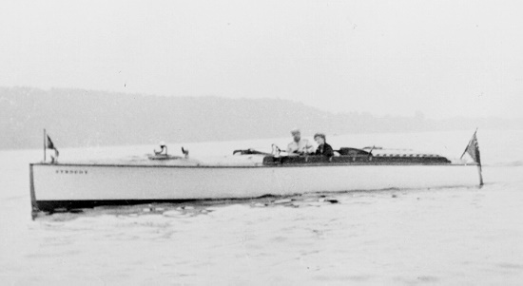
1982.0639
Anne Cameron

Slide 15
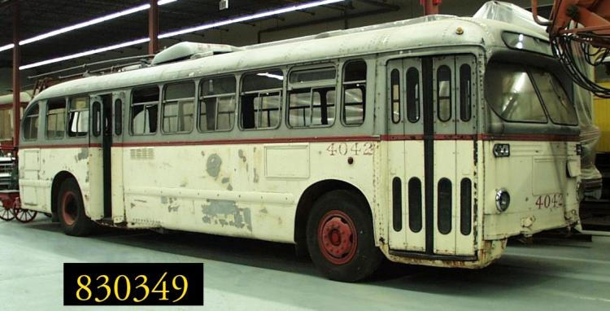
1983.0439
Amélia Poirier

Slide 16
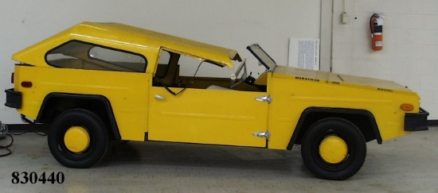
1983.0440
Philippe Giroux

Slide 17
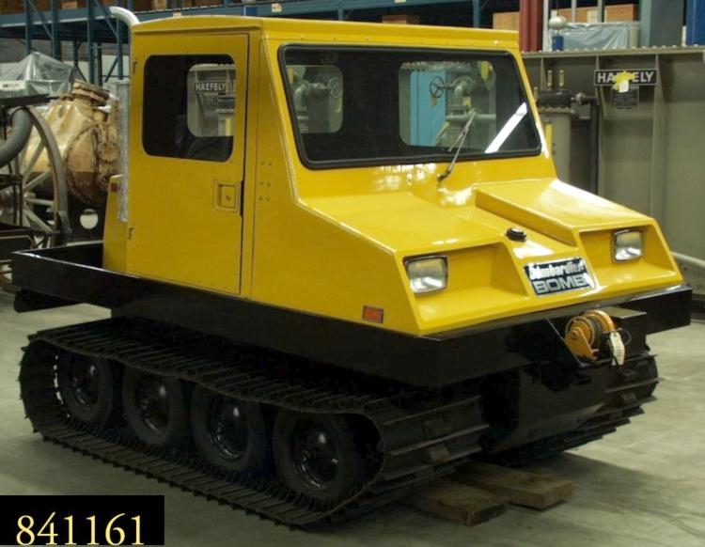
1984.1161
Justin Gobeil

Slide 18
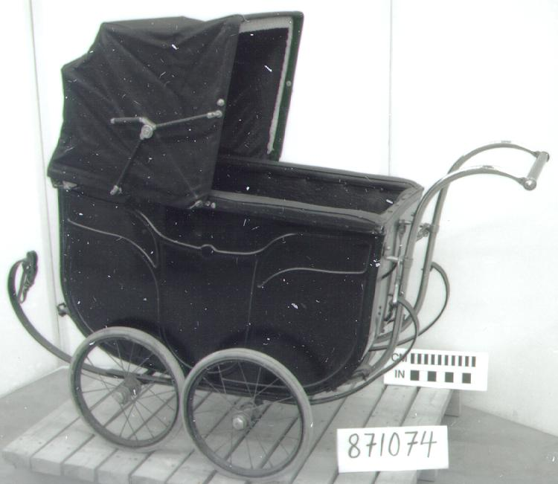
1987.1074
Melina Carrier

Slide 19
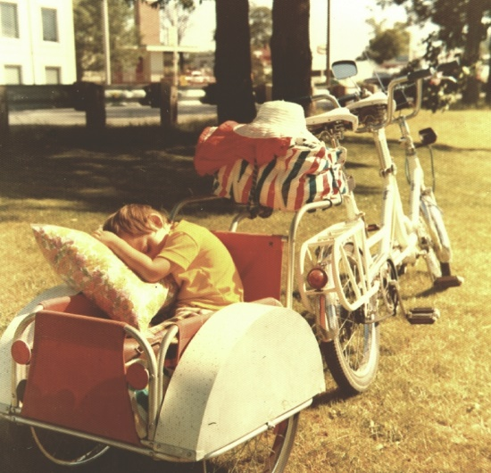
1998.0133
Xutianrui Wang

Slide 20
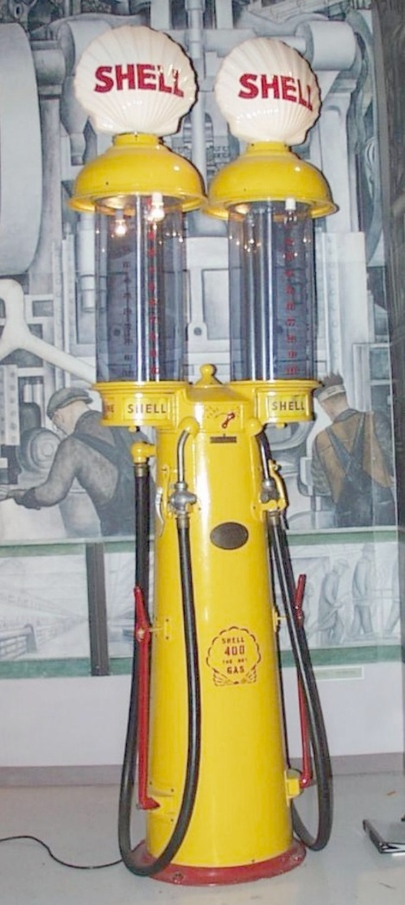
Material Culture Workshop

